Slide 1

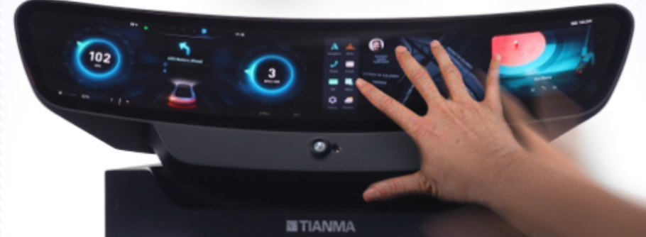
User's manual of Guiding Gui
无锡威莱斯电子有限公司

Slide 2
目录Contents
01
目的Purpose
02
RT介绍及原理说明
RT Introduction and principle description
03
获取RTGet RT
目录
Contents
04
Guiding gui RT标定使用说明
Guide GUI RT calibration instructions
05
Guiding gui 指尖跟踪使用说明
Guiding GUI fingertip tracking instructions
06
测试场景Test Scene
07
总结summary

Slide 3
目的
Purpose
01

Slide 4
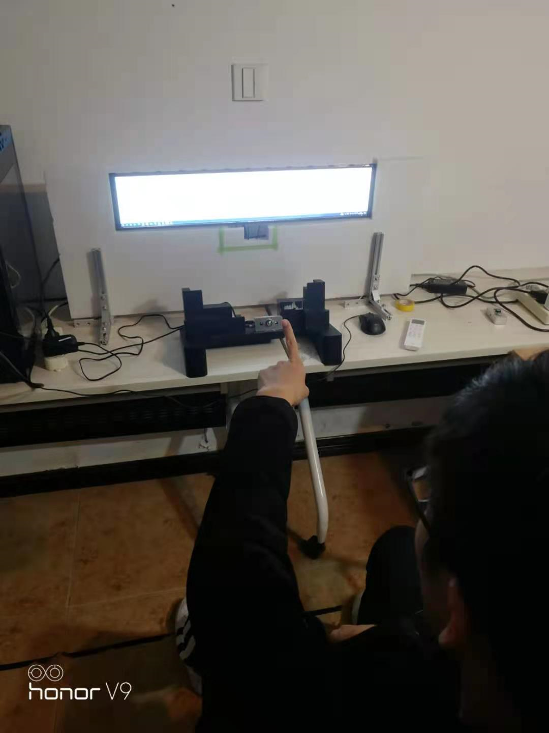
目的Purpose
【1】Guiding gui设计的目的:
The purpose of guiding gui design:
实现指尖点跟踪，在pc屏幕上实时显示指尖移动的轨迹
Achieve fingertip tracking, real-time display of fingertip movement on the PC screen.
【2】Guiding gui的核心内容：
Core content of Guiding gui:
坐标系的转换
coordinate transformation

Slide 5
RT介绍及原理说明
Introduction and
principle description
02

Slide 6
RT介绍Introduction to RT
RT概念：
RT concept：
R：由3x3矩阵组成
R：It is composed of 3x3 matrix，
r11,r12,r13:相机坐标到屏幕坐标的x轴的角度变换。
r11,r12,r13:Angle transformation from camera coordinate to X axis of screen coordinate.
r21,r22,r23:相机坐标到屏幕坐标的y轴的角度变换。
r21,r22,r23:Angle transformation from camera coordinate to Y axis of screen coordinate.
r31,r32,r33:相机坐标到屏幕坐标的z轴的角度变换。
r31,r32,r33:Angle transformation from camera coordinate to Z axis of screen coordinate.
R
r11 | r12 | r13
r21 | r22 | r23
r31 | r32 | r33

Slide 7
RT介绍Introduction to RT
T：由1x3矩阵组成
T：It is composed of 1x3 matrix
t1:相机坐标到屏幕坐标的x轴的平移量。
t1:The amount of translation from camera coordinates to X-axis of screen coordinates.
t2:相机坐标到屏幕坐标的y轴的平移量。
t2:The amount of translation from camera coordinates to the Y-axis of screen coordinates.
t3:相机坐标到屏幕坐标的z轴的平移量。
t3:The amount of translation of Z-axis from camera coordinates to screen coordinates.
RT是相机坐标系下坐标换算到屏幕坐标系坐标的关系矩阵。
RT is the relation matrix from camera coordinate system to screen coordinate system.
T
t1
t2
t3

Slide 8
RT原理说明RT principle description
guiding gui功能核心流程：
Guiding GUI function core process:
相机坐标系下指尖点至对应屏幕像素坐标点坐标换算流程：
Coordinate conversion process from fingertip to corresponding screen pixel coordinates in camera coordinate system:
相机坐标(/mm)
(Xc,Yc,Zc)
屏幕3D坐标(/mm)
(Xs,Ys,Zs)
屏幕2D坐标(/mm)
(Xs,Ys)
RT变换
去掉Zs
二次变换
像素坐标(/pix)
(u,v)

Slide 9
RT原理说明RT principle description
Camera coordinates(/mm)
(Xc,Yc,Zc)
Screen 3D coordinates(/mm)
(Xs,Ys,Zs)
Screen 2D coordinates(/mm)
(Xs,Ys)
RT transform
Remove ZS
Quadratic transformation
Pixel coordinates(/pix)
(u,v)

Slide 10
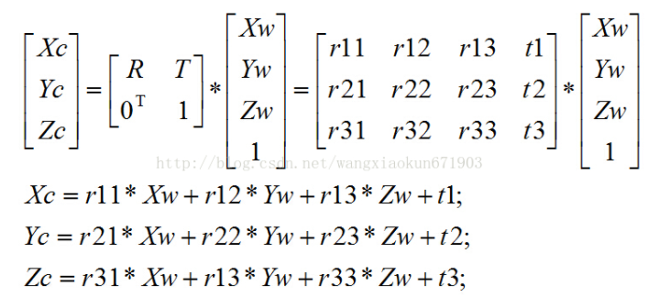
RT原理说明RT principle description
官方的世界坐标系，相机坐标系，图像坐标系，像素坐标系转换
Official world coordinate system, camera coordinate system, image coordinate system, pixel coordinate system
世界 ——> 相机 (外参：R,T )
World -- > camera (external reference: R, T)
[Xc,Yc,Zc]T表示相机坐标，[Xw,Yw,Zw，1]T表示归物体所在的世界坐标。R表示旋转矩阵，T表示平移矩阵。
[Xc, YC, ZC] T is the camera coordinate, [XW, YW, ZW, 1] T is the world coordinate of the object. R is the rotation matrix and T is the translation matrix.

Slide 11
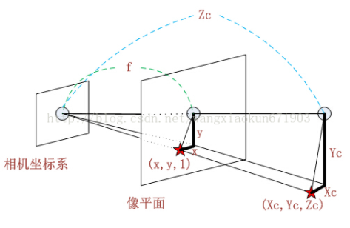
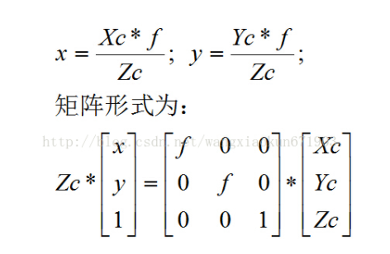
RT原理说明RT principle description
相机 ——> 图像 (内参：f)
Camera > image (internal reference: f)
从相机坐标系到图像坐标系，属于透视投影关系，从3D转换到2D。此时投影点p的单位还是mm，并不是pixel，需要进一步转换到像素坐标系
From the camera coordinate system to the image coordinate system, it belongs to perspective projection relationship, from 3D to 2D. At this time, the unit of projection point P is mm, not pixel, and needs to be further converted to pixel coordinate system
The matrix form is as follows:
Camera coordinates
Image plane
f表示焦距。[Xc,Yc,Zc]T表示相机坐标。[x,y,1]T表示归一化后的图像物理坐标
f is the focal length. [Xc, YC, ZC] T represents camera coordinates. [x, y, 1] T represents the normalized physical coordinates of the image.

Slide 12
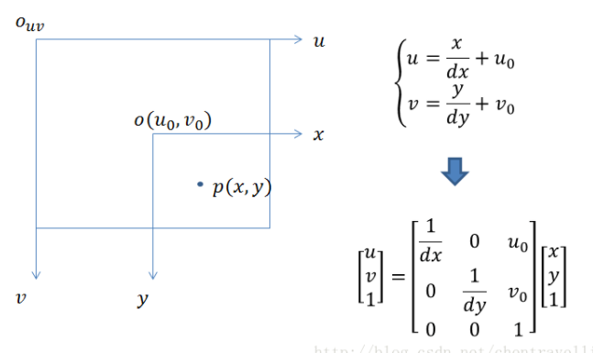
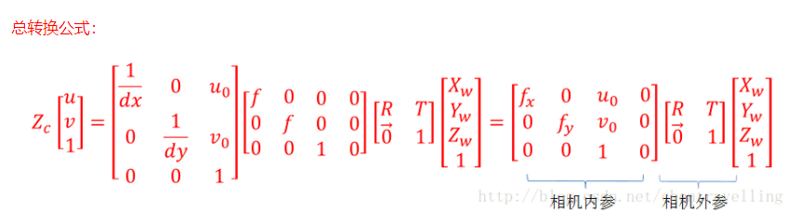
RT原理说明RT principle description
图像 ——>像素(内参：u0,v0)
Image -- > pixel (internal reference: u0, v0)
像素坐标系和图像坐标系都在成像平面上，只是各自的原点和度量单位不一样。图像坐标系的原点通常情况下是成像平面的中点，单位是mm，属于物理单位。而像素坐标系的单位是pixel，我们平常描述一个像素点都是几行几列。所以这二者之间的转换如下：其中dx和dy表示每一列和每一行分别代表多少mm，即1pixel=dx mm
Both pixel coordinate system and image coordinate system are on the imaging plane, but their origin and measurement unit are different. The origin of the image coordinate system is usually the midpoint of the imaging plane, the unit is mm, which belongs to the physical unit. The unit of pixel coordinate system is pixel. We usually describe a pixel as several lines and columns. So the conversion between the two is as follows: where dx and dy represent how many mm each column and row represents respectively, that is, 1pixel = dx mm.
Camera external parameters
Camera external parameters

Slide 13
获取RT
Get RT
03

Slide 14
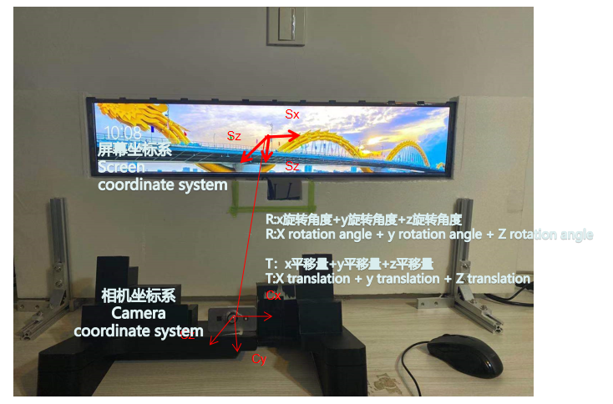
获取RT Get RT
Guiding Gui实际场景坐标展示
Guiding GUI actual scene coordinate display

Slide 15
获取RT Get RT
RT标定中涉及到相机坐标，屏幕3D坐标系，图像像素坐标系。
RT calibration involves camera coordinate, screen 3D coordinate system and image pixel coordinate system.
相机坐标
Camera coordinate system
图像像素坐标系
Image pixel coordinate system
U
Xc
Zc
Yc
V

Slide 16
获取RT Get RT
屏幕3D坐标系
Screen 3D coordinate system
坐标系合体
Coordinate system combination
U
V
Xs
Xs
Zs
Xc
Ys
Ys
Zc
Zs
Yc

Slide 17
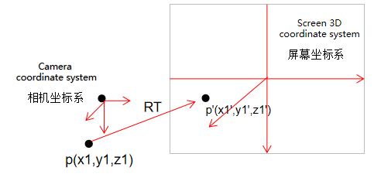
获取RT Get RT
RT是如何参与相机坐标系到屏幕坐标系转换的工作呢?
How does RT participate in the transformation from camera coordinate system to screen coordinate system?
假设：相机坐标系下有点p(x1,y1,z1),我们要通过RT求得p点在屏幕坐标系上对应的点p'(x1',y1',z1')，如图是RT参与点转换的模拟。
Suppose: there is a point P (x1, Y1, z1) in the camera coordinate system. We need to obtain the corresponding point P '(x1', Y1 ', Z1') of point P in the screen coordinate system through RT. the figure shows the simulation of RT participating in point conversion

Slide 18
获取RT Get RT
采用的公式是：
The formula used is：
screen=camera*R+T
screen是要求的屏幕3D坐标，camera已有的相机3D坐标。
Screen is the required screen 3D coordinates，
Camera 3D coordinates of the existing camera.
screen=camera*R+T详细的公式计算：
screen=camera*R+T detailed formula calculation:
x1'=r11*x1+r12*y1+r13*z1+t1
y1'=r21*x1+r22*y1+r23*z1+t2
z1'=r31*x1+r32*y1+r33*z1+t3
因此：RT矩阵运用的地方是相机坐标系到屏幕坐标系的转换，最终得到的是屏幕3D坐标。
Therefore: RT matrix is used in the transformation from camera coordinate system to screen coordinate system, and the final result is screen 3D coordinate.

Slide 19
获取RT Get RT
那么在RT不知道的情况下，是怎么反求RT的呢？
So how to reverse RT when RT doesn't know?
反求RT用到的公式如下：
The formula used in reverse calculation of RT is as follows：
screen=camera*R+T
此处需要手动测量屏幕3D坐标（screen）和相机3D坐标（camera）
由于R,T一共是12个参数，而一组坐标代入公式产生3个方程，因此需要4组坐标点才能求出R,T。
Here you need to manually measure the screen 3D coordinates and camera 3D coordinates
Because R and T are 12 parameters in total, and a set of coordinates into the formula produces three equations, so it needs four groups of coordinate points to get R, t.
求出RT需要做的工作：手动测量屏幕3D坐标（screen），利用guiding gui录取相机3D坐标（camera）。
The work needed to be done in RT: manually measure the screen 3D coordinates, and use guiding GUI to record camera 3D coordinates.

Slide 20
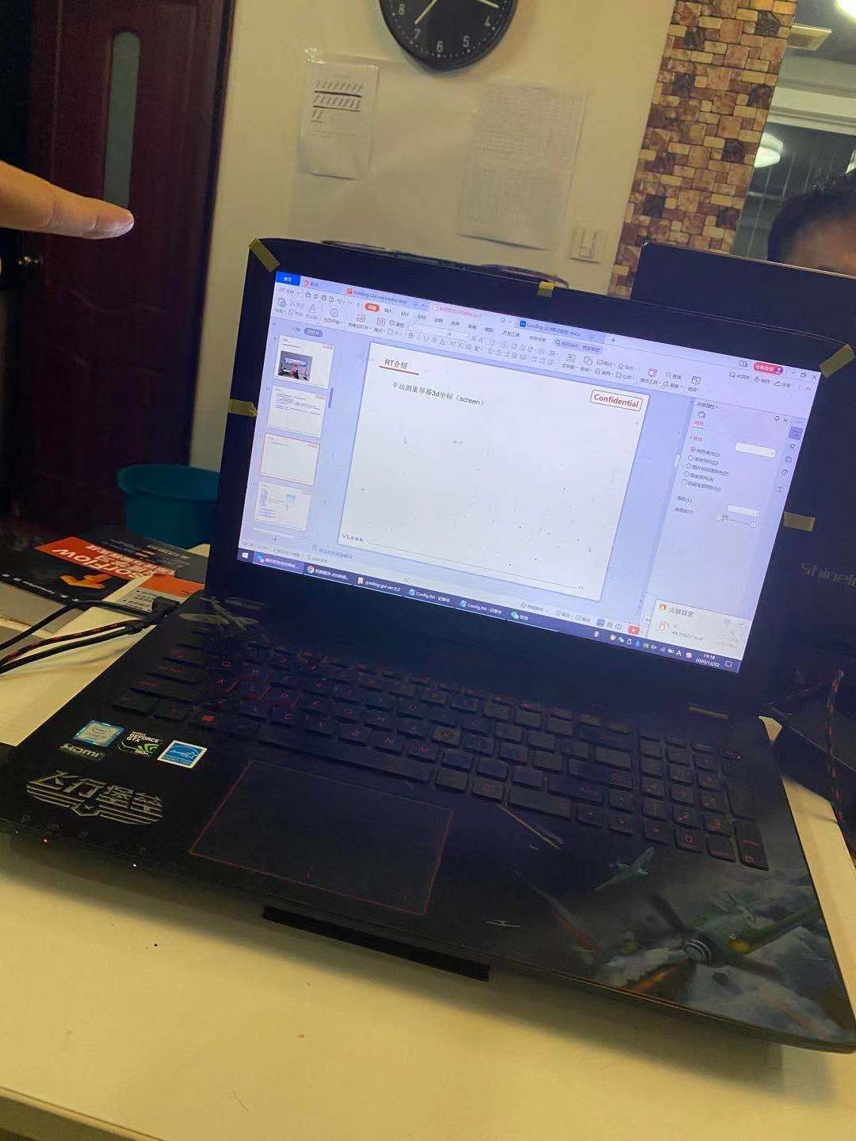
标定说明Calibration Instructions
手动测量屏幕3d坐标（screen）
Manual measurement of screen 3D coordinates
step1：测量pc屏幕最左上角的点，记为point_one(x1,y1,z1)
step1：Measure the point at the top left corner of the PC screen and record it as point_ one(x1,y1,z1)
z1
x1=-width/2
y1=-height/2
z1=指尖到屏幕距离(Distance from fingertip to screen)
width：pc屏幕宽(PC screen width)
height：pc屏幕高(PC screen height)
point_one(x1,y1,z1)

Slide 21
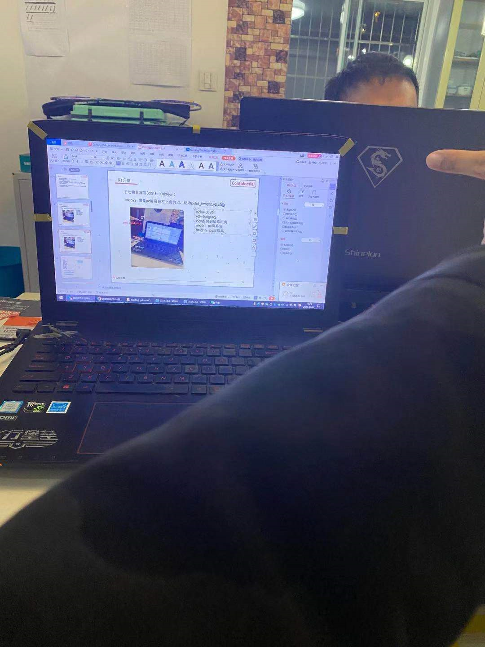
标定说明Calibration Instructions
step2：测量pc屏幕最右上角的点，记为point_two(x2,y2,z2)
step2：Measure the point at the top left corner of the PC screen and record it as point_two(x2,y2,z2)
z2
point_two(x2,y2,z2)
x2=width/2
y2=-height/2
z2=指尖到屏幕距离(Distance from fingertip to screen)
width：pc屏幕宽(PC screen width)
height：pc屏幕高(PC screen height)

Slide 22
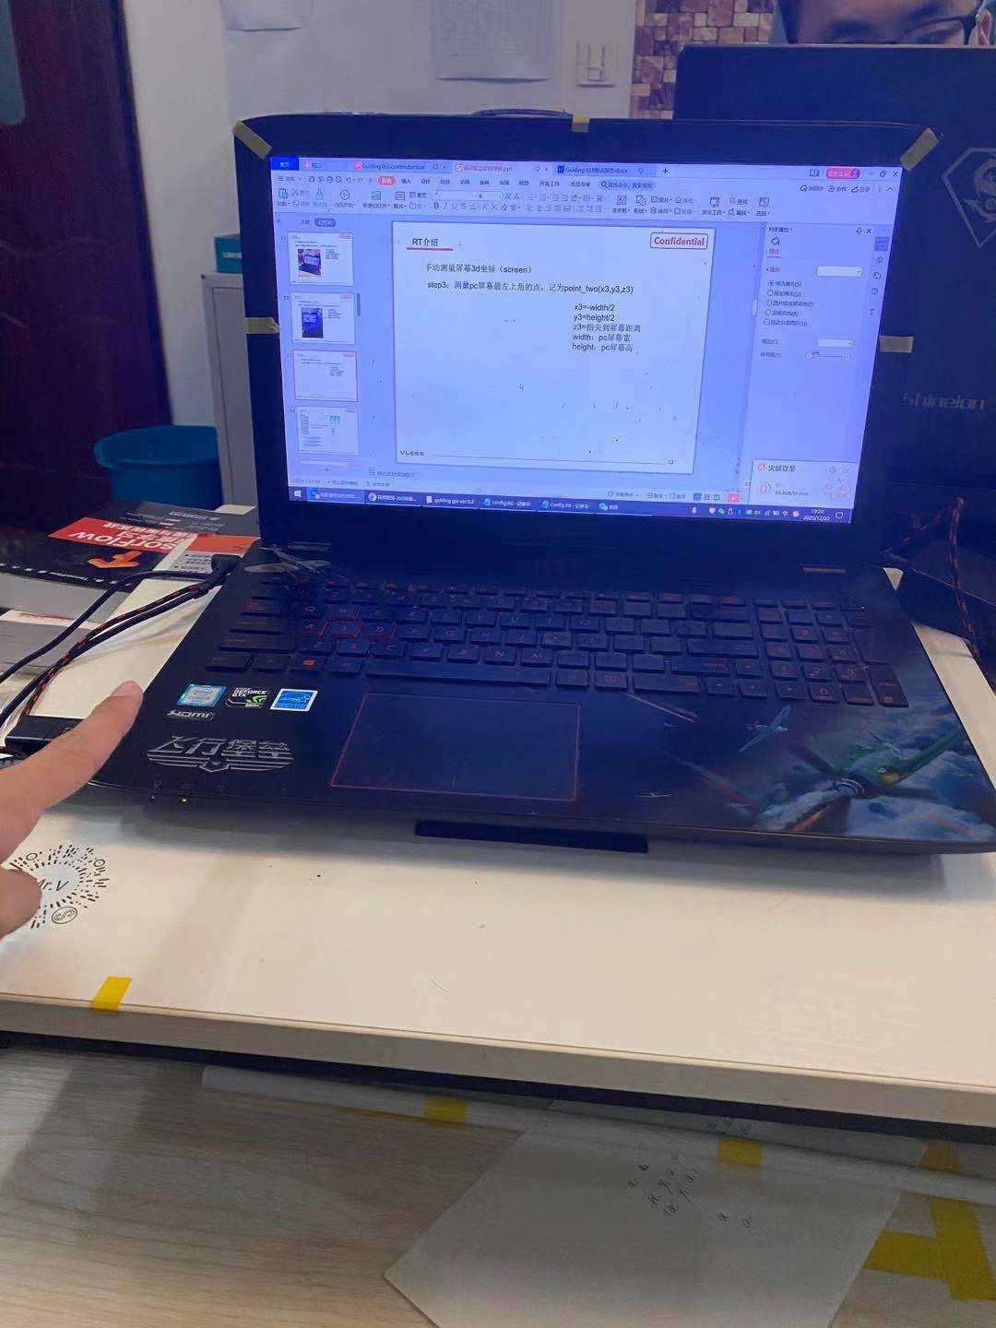
标定说明Calibration Instructions
step3：测量pc屏幕最左下角的点，记为point_three(x3,y3,z3)
step3：Measure the point at the top left corner of the PC screen and record it as point_three(x3,y3,z3)
x3=-width/2
y3=height/2
z3=指尖到屏幕距离(Distance from fingertip to screen)
width：pc屏幕宽(PC screen width)
height：pc屏幕高(PC screen height)
z3
point_three(x3,y3,z3)

Slide 23
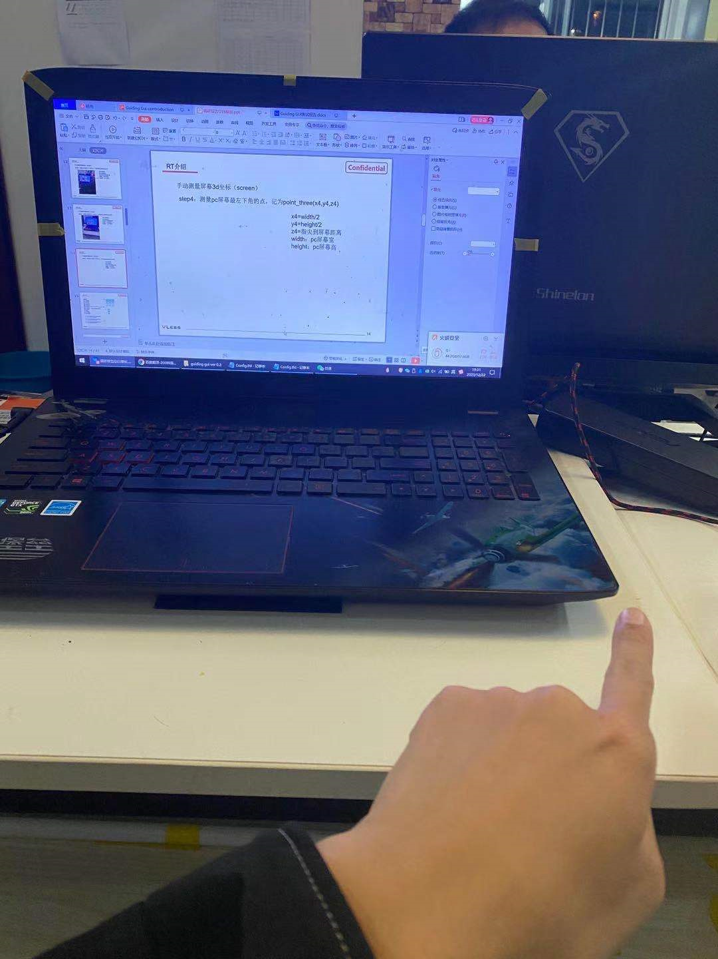
标定说明Calibration Instructions
step4：测量pc屏幕最左下角的点，记为point_four(x4,y4,z4)
step4：Measure the point at the top left corner of the PC screen and record it as point_four(x4,y4,z4)
x4=width/2
y4=height/2
z4=指尖到屏幕距离(Distance from fingertip to screen)
width：pc屏幕宽(PC screen width)
height：pc屏幕高(PC screen height)
z4
point_four(x4,y4,z4)

Slide 24
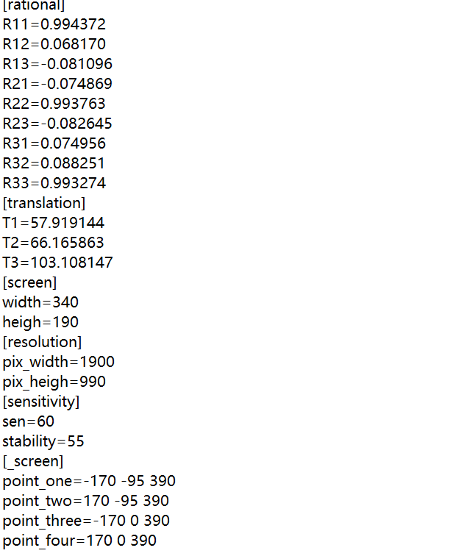
标定说明Calibration Instructions
step5：将测量的4组点写入config文件，写入位置如图红色框出来的部分，对应添加到文件中，至此屏幕3D坐标已有。
step5：Write the measured 4 groups of points into the config file. The writing position is shown in the red box in the figure, and it is added to the file accordingly. So far, 3D coordinates on the screen are available.

Slide 25
guiding gui RT标定使用说明
Guiding Gui
Instructions for RT calibration
04

Slide 26
标定说明Calibration Instructions
step6：修改config文件中pc的屏幕分辨率，pc物理尺寸，如图红框处。
step6：Modify the screen resolution and physical size of PC in config file, as shown in the red box.
物理尺寸Physical size
屏幕分辨率
Screen resolution

Slide 27
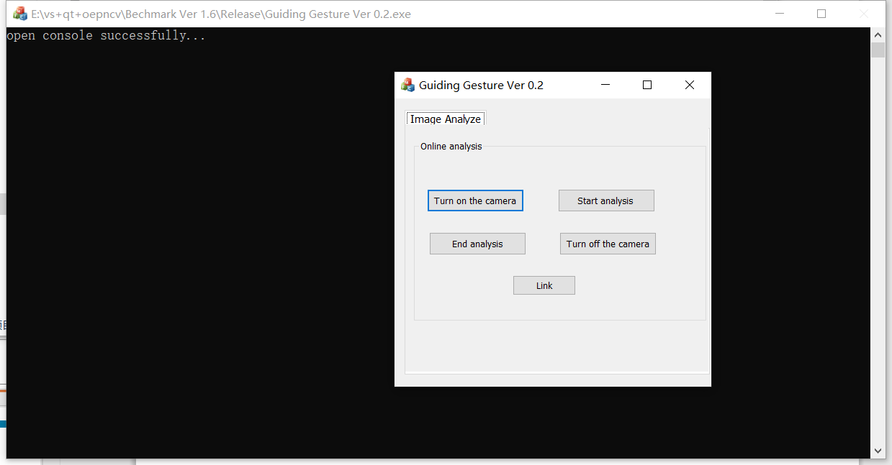
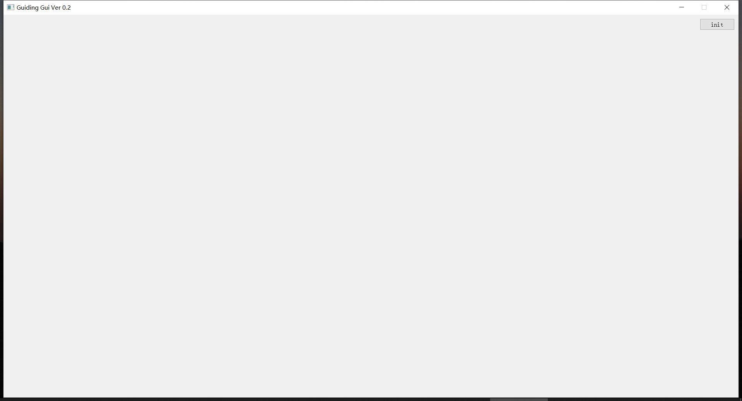
标定说明Calibration Instructions
利用guiding gui录取相机3D坐标（camera）。
Using guiding GUI to record camera 3D coordinates.
step1 打开guiding gui,guiding gesture
step1 Open guiding GUI, guiding texture

Slide 28
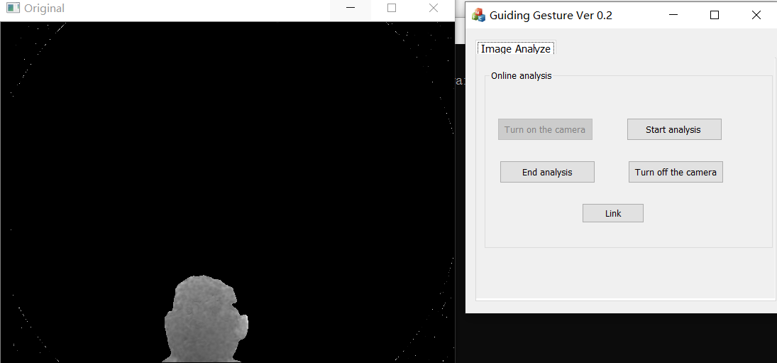
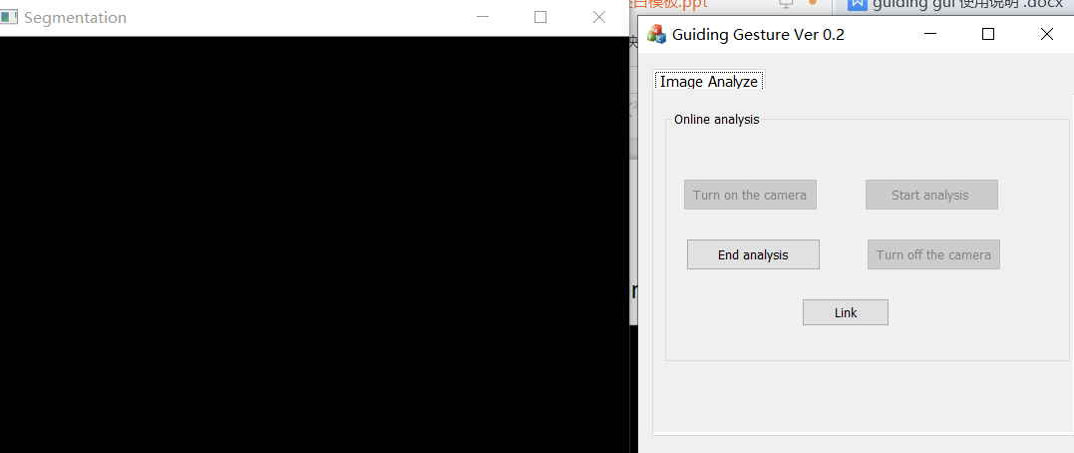
标定说明Calibration Instructions
step2点击guiding gesture 的turn on the camera
step2 Click turn on the camera of guiding gesture
step3 点击guiding gesture 的start analysis
step3 Click start analysis of guiding texture

Slide 29

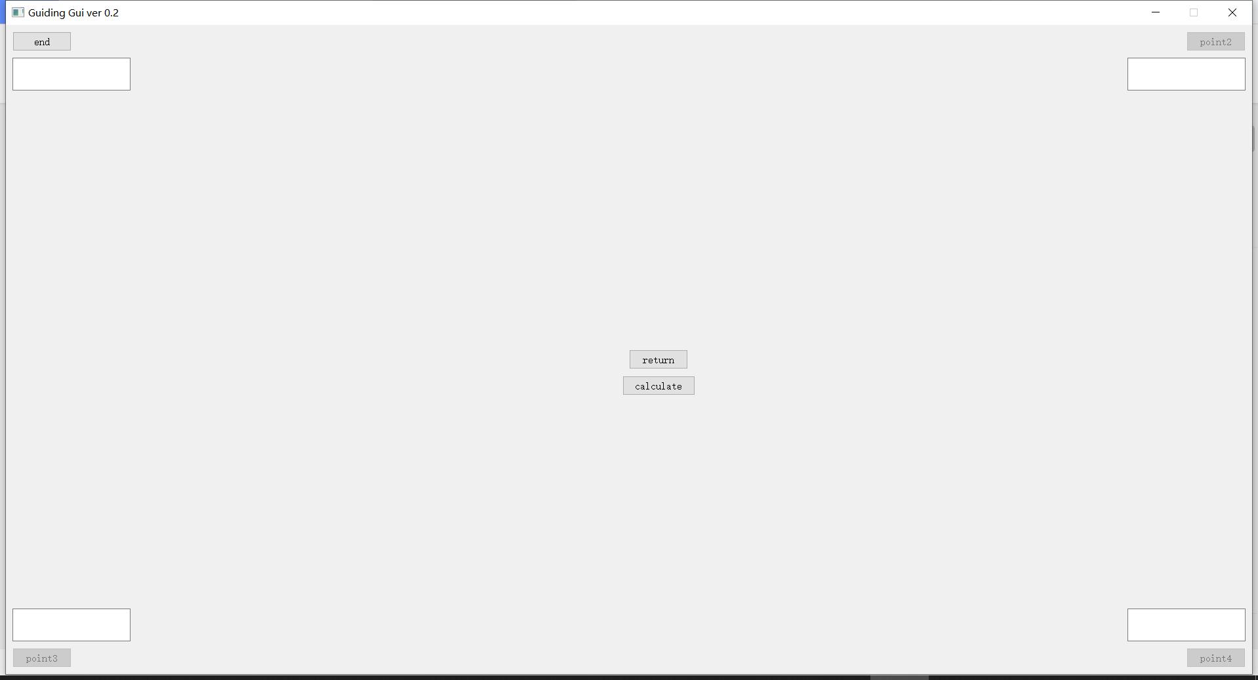
标定说明Calibration Instructions
step4点击guiding gui主界面的init
step4 Click init in the main GUI interface
step5点击guiding gui标定界面point1（相机坐标第一个点录取从此处开始）
step5Click pointing GUI calibration interface point1 (the first point of camera coordinates is taken from here)

Slide 30
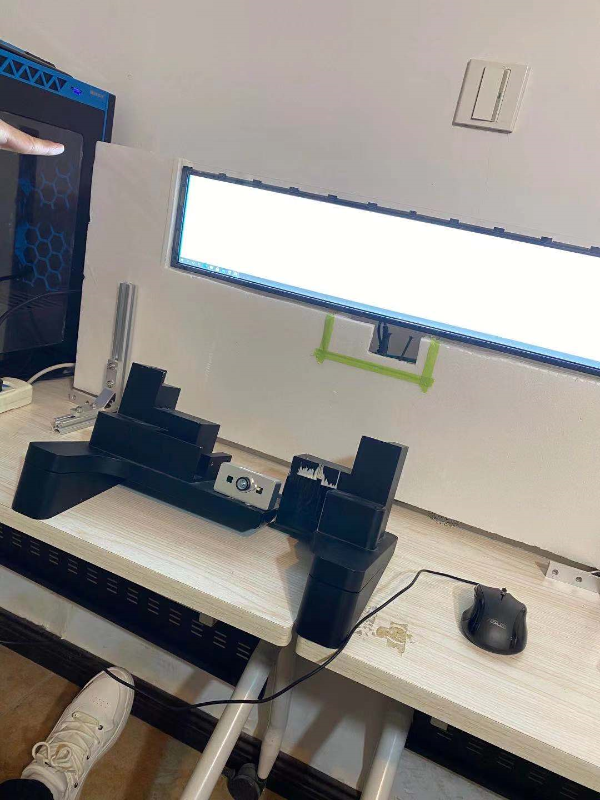
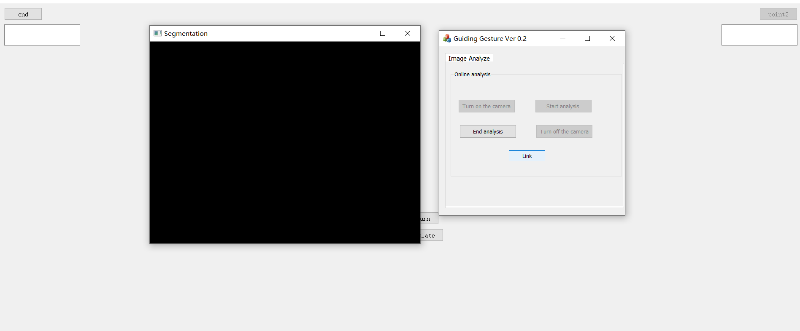
标定说明Calibration Instructions
step6指尖放在屏幕左上角
step6 Put your fingertips in the top left corner of the screen
step7点击guiding gesture 的Link
step7 Click "link" in guiding gesture

Slide 31
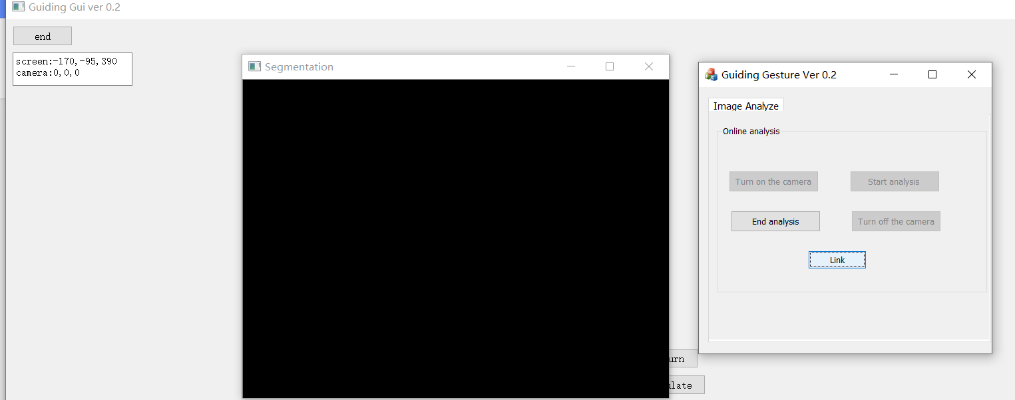
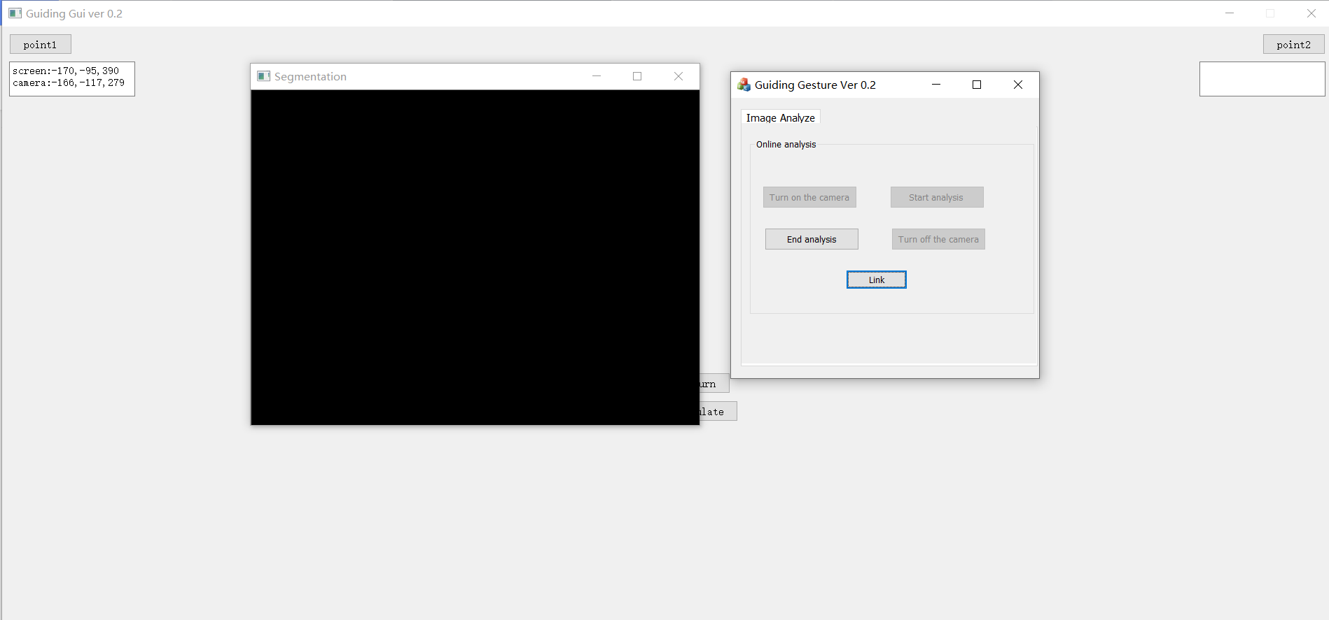
标定说明Calibration Instructions
step8 手指静止，当按钮值“end”再次变成point1，表示点录取完成。
step8 The finger is still. When the button value "end" changes to "point1" again, it means that the point acquisition is completed.

Slide 32
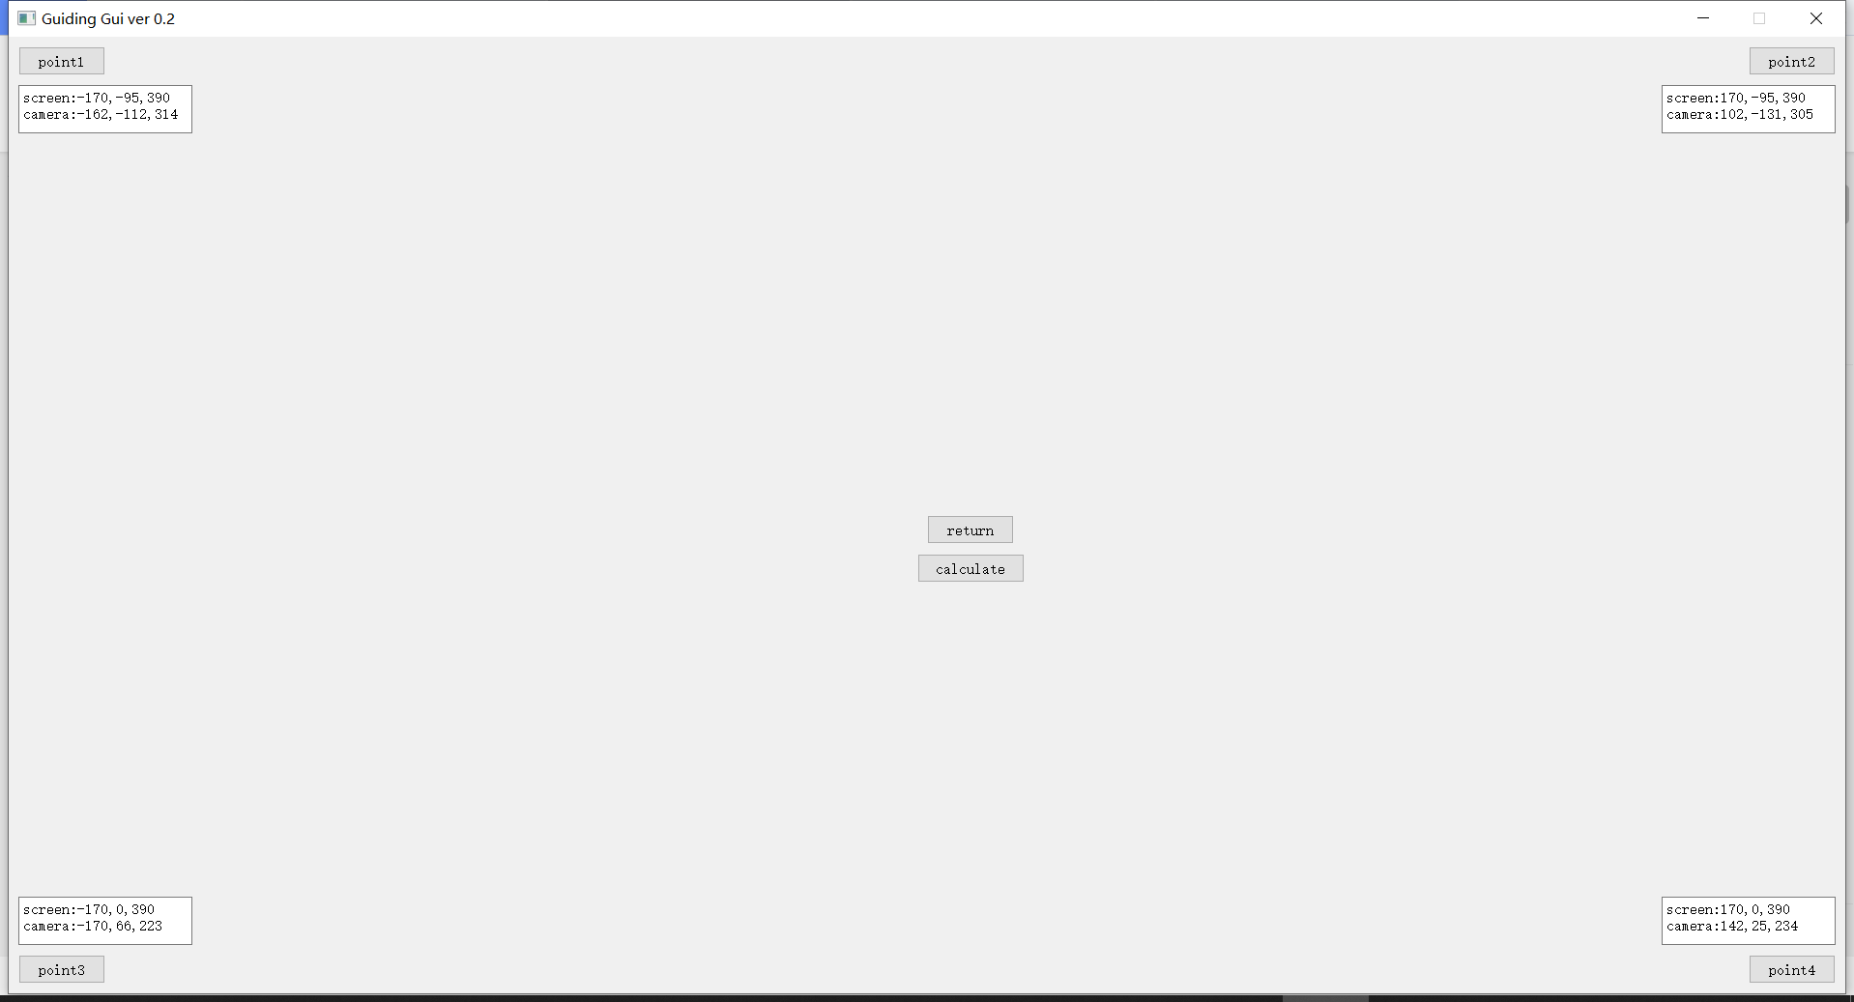
标定说明Calibration Instructions
step9点击guiding gui 的point2，重复step5-step8（point2录取）
step9 Click "point2" of guiding GUI and repeat step5-step8 (point2 admission)
step10 点击guiding gui 的point3，重复step5-step8（point3录取）
step10 Click "point3" of guiding GUI and repeat step5-step8 (point3 admission)
step11 点击guiding gui 的point4，重复step5-step8（point4录取）
step11 Click "point4" of guiding GUI and repeat step5-step8 (point4 admission)
4点录取完后，在对应文本框显示
After 4 coordinate points are recorded, they will be displayed in the corresponding text box

Slide 33
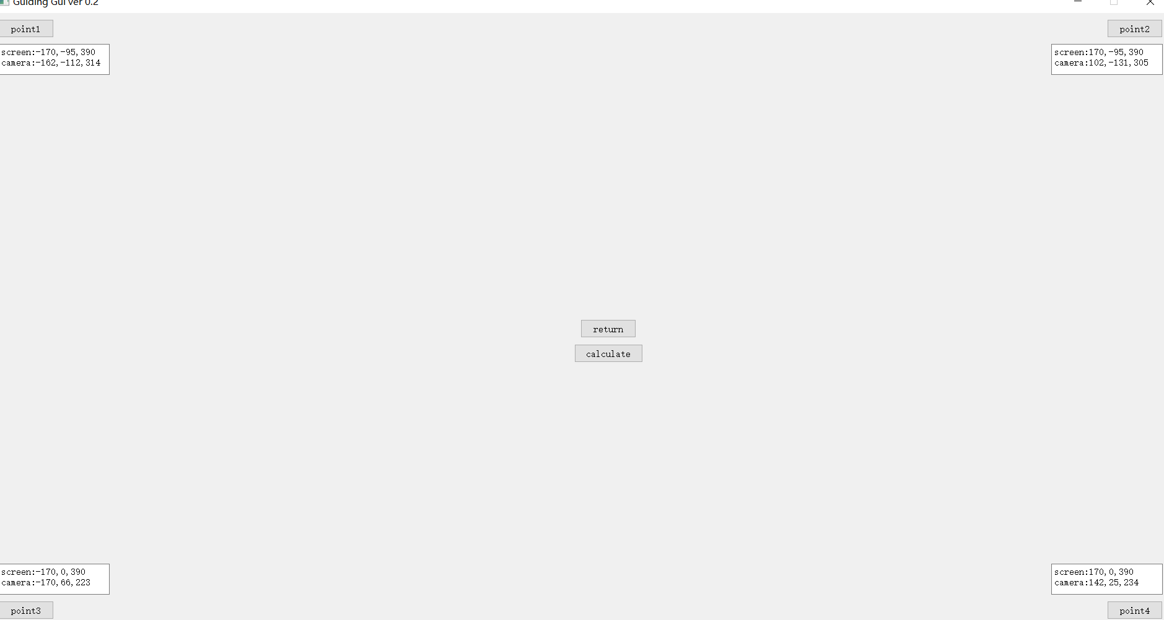
标定说明Calibration Instructions
step12 点击guiding gui 的calculate
step12 Click "calculate" in guiding GUI

Slide 34
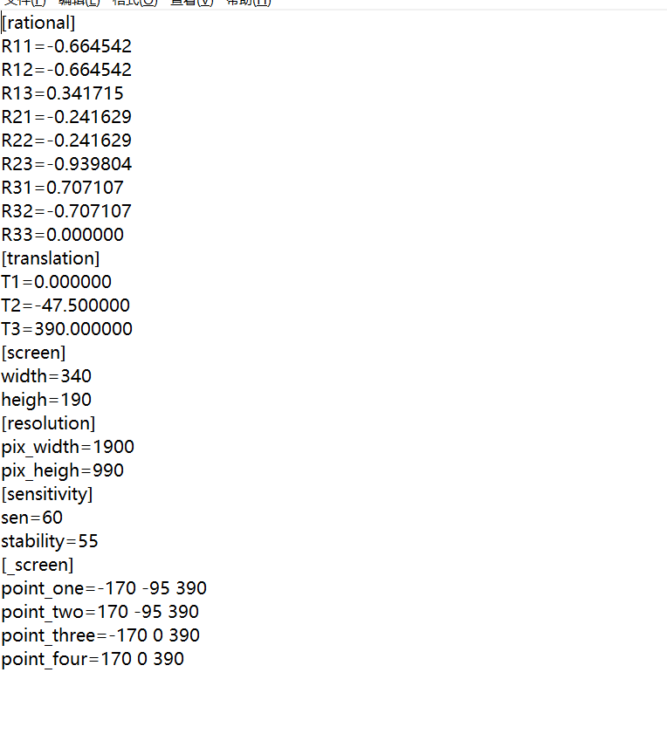
标定说明Calibration Instructions
step13可点击guiding gui 的return测试RT求解的结果。
step13Click "return" in guiding GUI to test the result of RT solution.
求得RT保存在config文件中
Get RT and save it in the config file.

Slide 35
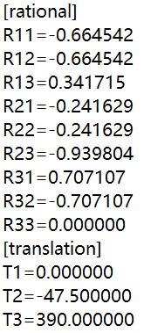
标定说明Calibration Instructions
config文件文件中求得RT通过程序转换得到公式可用的RT
The RT can be obtained from the config file, and the RT that can be used by formula can be obtained by program transformation
R
R11 | R12 | R13
R21 | R22 | R23
R31 | R32 | R33
通过程序转换成RT矩阵
T
T1
T2
T3

Slide 36
标定说明Calibration Instructions
R11,R12,R13:相机X轴到屏幕X轴的旋转角度
R11,R12,R13:Rotation angle of camera X axis to screen X axis
T1：相机X轴到屏幕X轴的平移量
T1：Translation amount of camera X axis to screen X axis
R21,R22,R23:相机Y轴到屏幕Y轴的旋转角度
R21,R22,R23:Rotation angle of camera Y axis to screen Y axis
T2：相机Y轴到屏幕Y轴的平移量
T2：Translation amount of camera Y axis to screen Y axis
R31,R32,R33:相机Z轴到屏幕Z轴的旋转角度
R31,R32,R33:Rotation angle of camera Z axis to screen Z axis
T3：相机Z轴到屏幕Z轴的平移量
T3：Translation amount of camera Z axis to screen Z axis

Slide 37
标定说明Calibration Instructions
反求RT公式详解
Detailed explanation of reverse RT formula
通过上面所求得屏幕3D坐标点和相机坐标点，如下列出
The screen 3D coordinates and camera coordinates obtained from the above are listed below
屏幕3D坐标点：point_one(x1,y1,z1)，point_two(x2,y2,z2)，point_three(x3,y3,z3),point_four(x4,y4,z4)
3D coordinates of screen：point_one(x1,y1,z1)，point_two(x2,y2,z2)，point_three(x3,y3,z3),point_four(x4,y4,z4)
相机坐标点：point1(x1',y1',z1')，point2(x2',y2',z2'),point3(x3',y3',z3'),point4(x4',y4',z4')
Camera coordinates：point1(x1',y1',z1')，point2(x2',y2',z2'),point3(x3',y3',z3'),point4(x4',y4',z4')
代入如下公式
Put in the following formula
screen(已知)=camera(已知)*R+T
screen(Known)=camera(Known)*R+T
解得：R T。
Solution：R T。

Slide 38
标定说明Calibration Instructions
x1=r11*x1'+r12*y1'+r13*z1'+t1
y1=r21*x1'+r22*y1‘+r23*z1'+t2
z1=r31*x1'+r32*y1’+r33*z1'+t3
x2=r11*x2'+r12*y2'+r13*z2'+t1
y2=r21*x2'+r22*y2‘+r23*z2'+t2
z2=r31*x2'+r32*y2’+r33*z2'+t3
x3=r11*x3'+r12*y3'+r13*z3'+t1
y3=r21*x3'+r22*y3‘+r23*z3'+t2
z3=r31*x3'+r32*y3’+r33*z3'+t3
x4=r11*x4'+r12*y4'+r13*z4'+t1
y4=r21*x4'+r22*y4‘+r23*z4'+t2
z4=r31*x4'+r32*y4’+r33*z4'+t3
解得
Solution
r11 r12.....r33
t1 t2 t3

Slide 39
标定说明Calibration Instructions
屏幕3D坐标(Xs,Ys,Zs)至屏幕2D坐标(Xs,Ys)：
Screen 3D coordinates (Xs,Ys,Zs) to screen 2D coordinates (Xs,Ys)：
去掉Zs
Remove Zs

Slide 40
标定说明Calibration Instructions
屏幕2D坐标(Xs,Ys)转像素坐标(u,v)
Screen 2D coordinates (Xs,Ys) to pixel coordinates (u,v)
u
Ys
Xs
(max_pix_width/2,max_pix_height/2)
Ys
v
方法：
method:
取Xs,Ys利用如下公式计算u,v：
Take XS, Ys and use the following formula to calculate u,v：
u=Xs*(max_pix_width/max_width)+max_pix_width/2
v=Ys*(max_pix_height/max_height)+max_pix_height/2
max_pix_width/max_pix_height(/pixel)：屏幕分辨率宽高(PC Screen resolution width and height)
max_width/max_height(/mm)：pc物理尺寸宽高(PC physical size width and height）

Slide 41
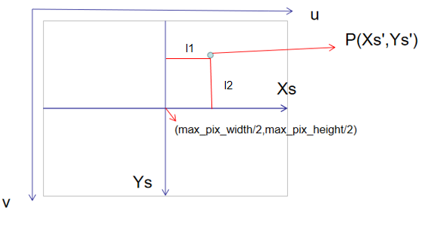
标定说明Calibration Instructions
max_pix_width/max_width/max_pix_height/max_height:单位mm内有多少个像素。
max_pix_width/max_width/max_pix_height/max_height:How many pixels are there in 1mm.
例如：求坐标系中有屏幕坐标点P(Xs',Ys'),将其转换成像素坐标P'(u',v')？
For example：Find the screen coordinate point P (Xs',Ys') in the coordinate system and convert it into pixel coordinate p '(u',v')?
假设:屏幕分辨率为1920x1080(pixel),pc物理尺寸为340x190(mm)
Hypothesis:The screen resolution is 1920x1080 (pixel), and the physical size of PC is 340x190 (mm)
u'=Xs'*(1920/340)+1920/2
v'=Ys'*(1080/190)+1080/2
l1=Xs'*(1920/340)
l2=Ys'*(1080/190)

Slide 42
guiding gui 指尖跟踪使用说明Guiding Gui
Fingertip tracking instructions
05

Slide 43
使用说明 Instructions
程序使用：
Program usage：
指尖点跟踪功能使用
Fingertip tracking function is used.

Slide 44
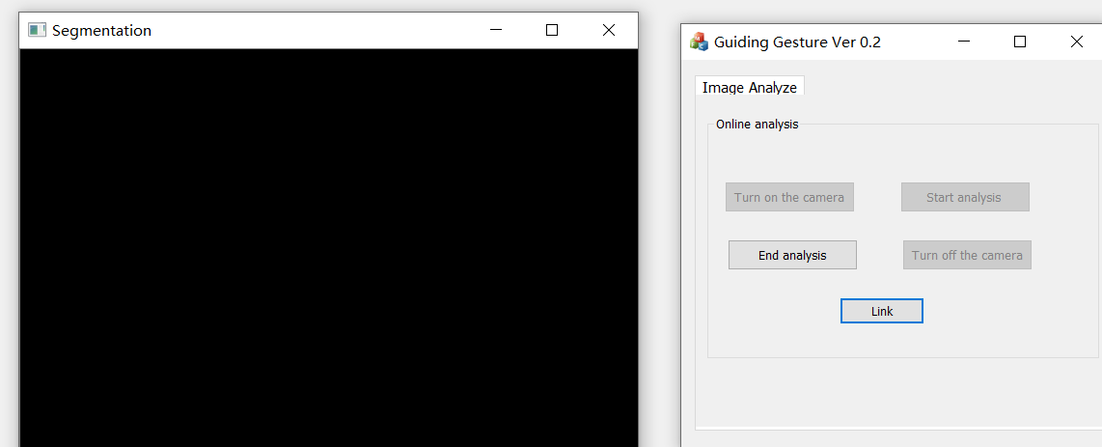
使用说明 Instructions
指尖点跟踪功能使用
Use of fingertip tracking function
step1 打开guiding gui，guiding gestue
step1 Open guiding GUI, guiding gestue
step2 点击guiding gesture 的turn on camera ->start analys->Link开始实现功能
step2 Click "turn on camera" > "start analyses" > "link" of guiding texture to realize the function
See Guiding gui Operation animation.MP4

Slide 45
测试场景
Test scene
06

Slide 46
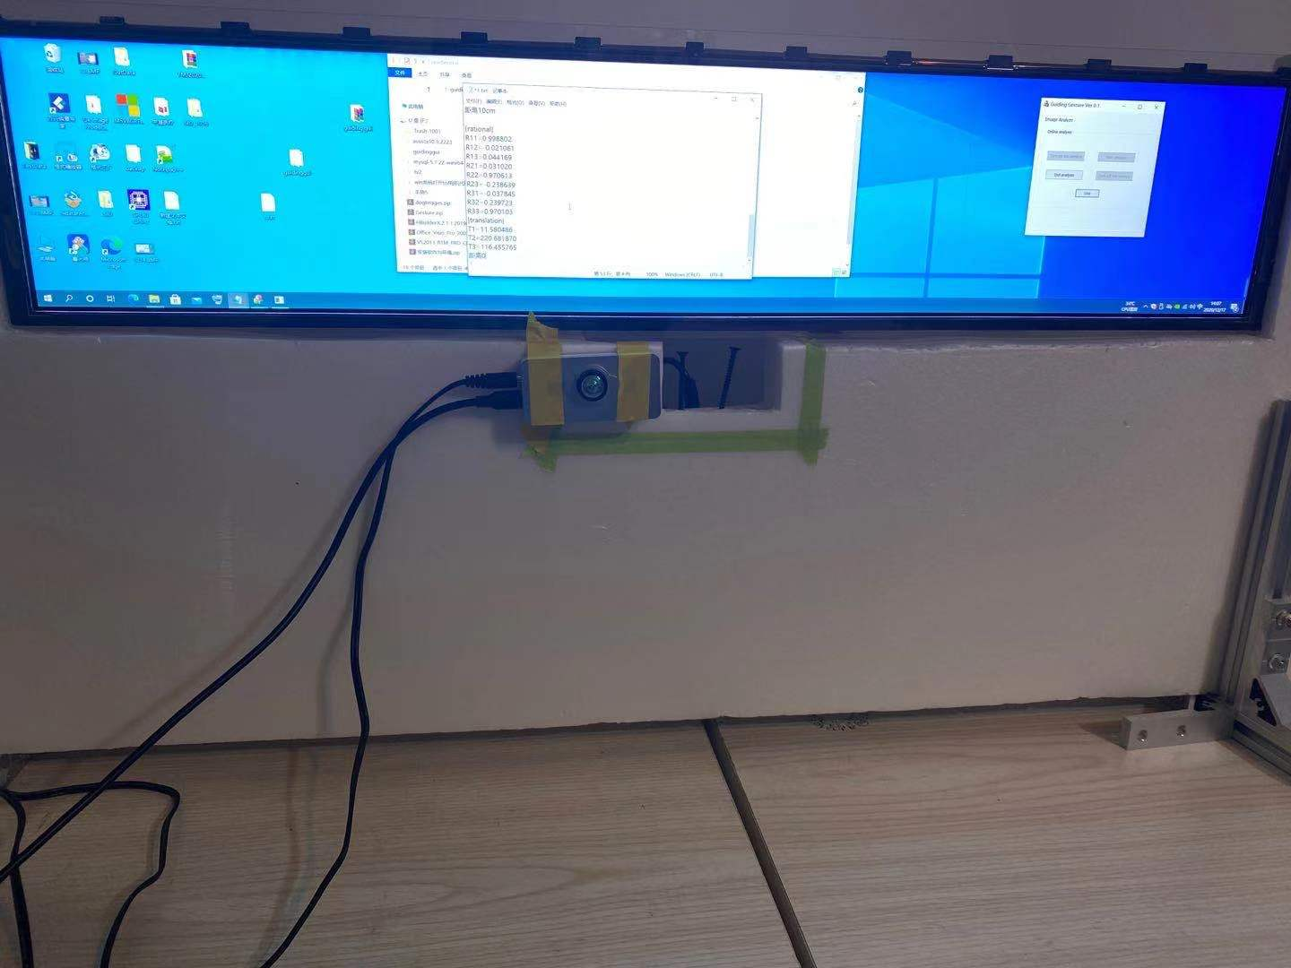
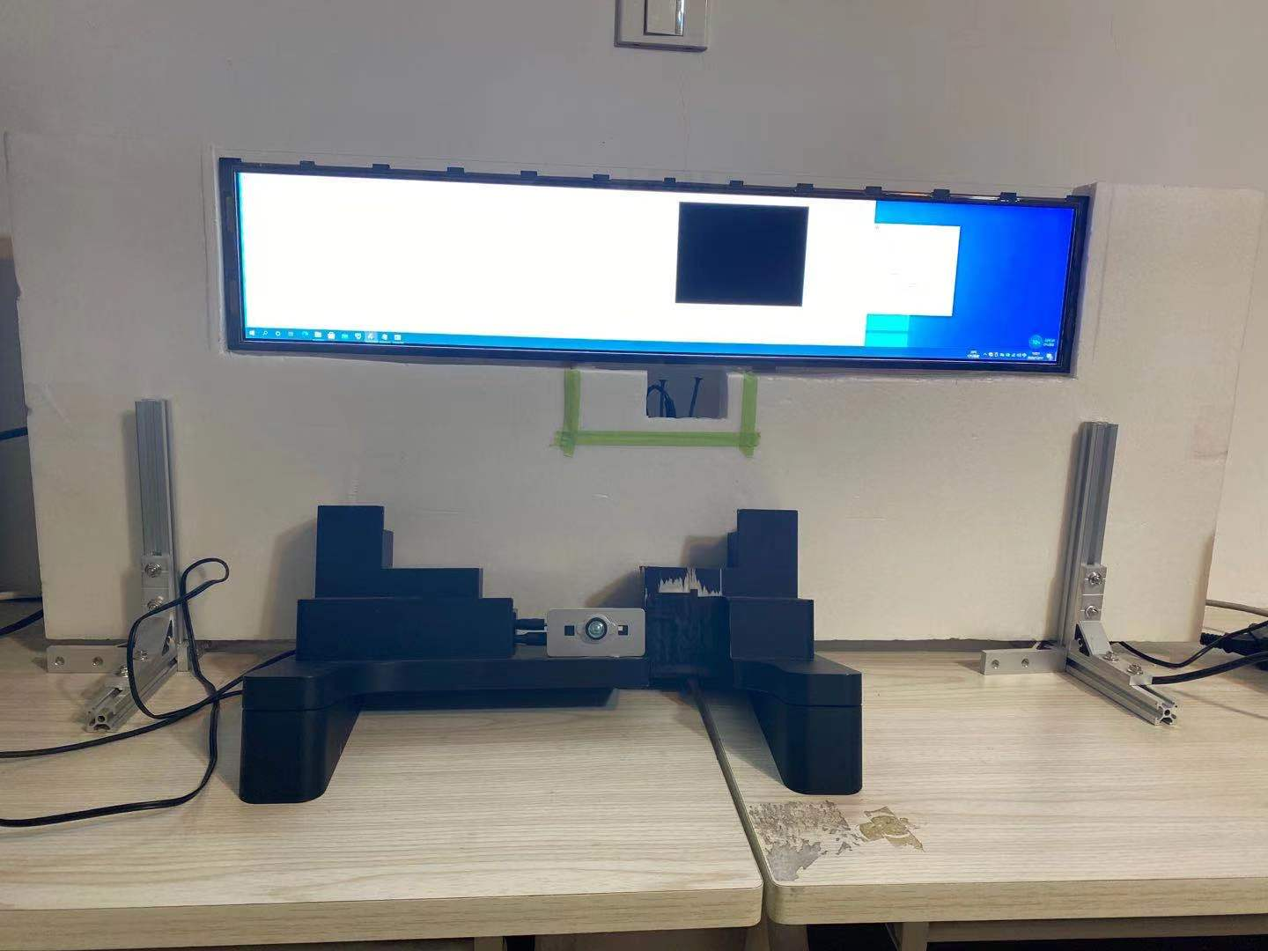
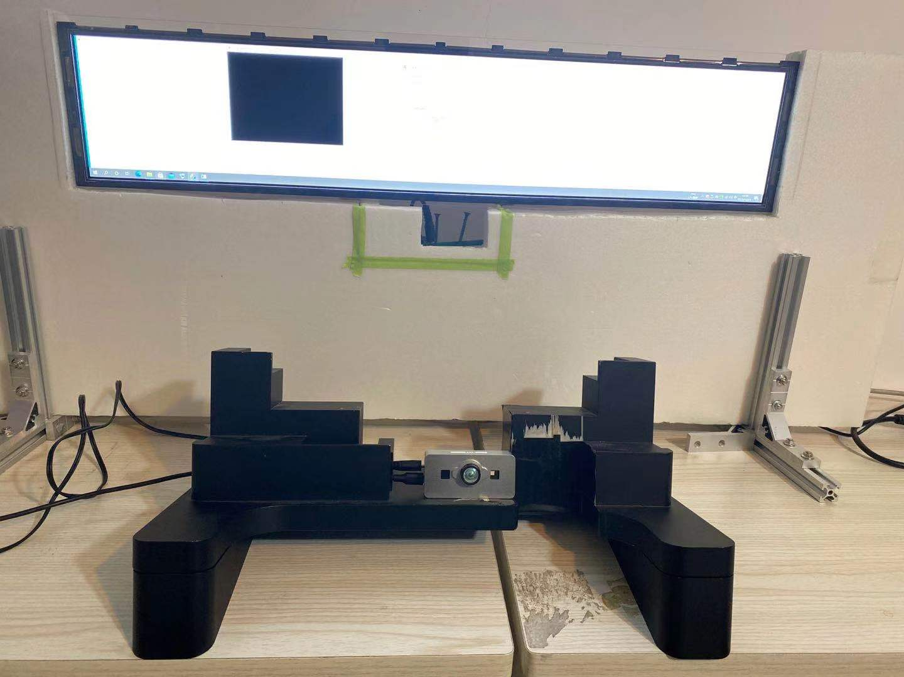
测试场景Test scene
pc屏幕分辨率 PC screen resolution | 相机距离屏幕距离d(/cm) Distance between camera and screen d(/cm) | 相机位姿Camera pose
4032x756 | 0
4032x756 | 10
4032x756 | 20

Slide 47
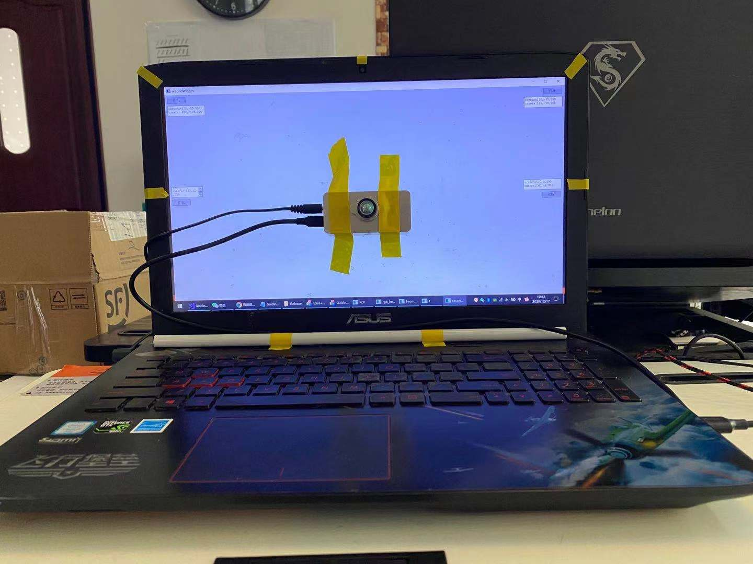
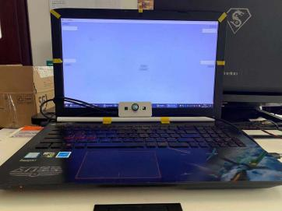
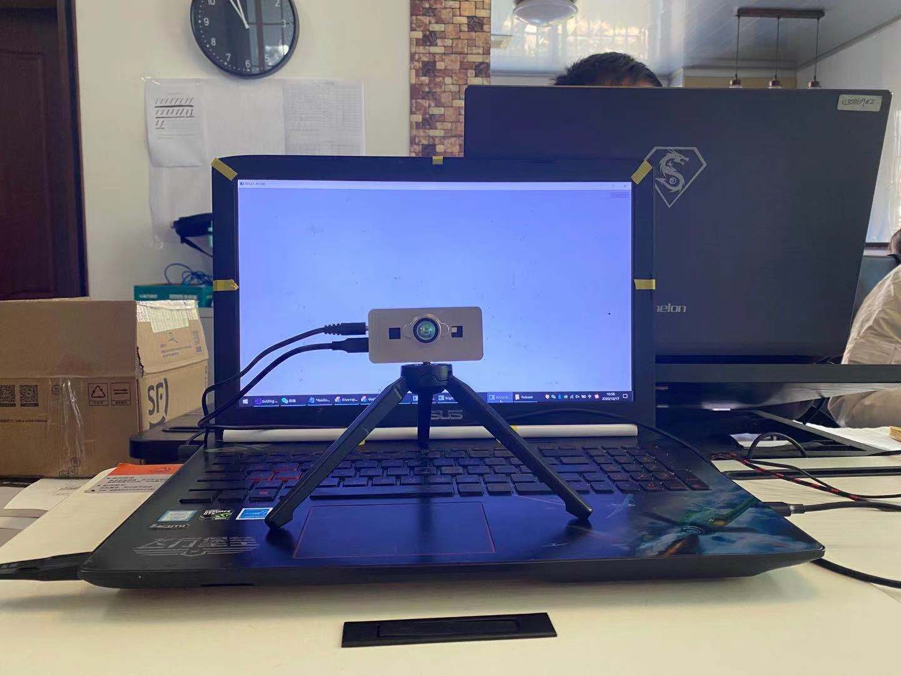
测试场景Test scene
pc屏幕分辨率 PC screen resolution | 相机距离屏幕距离d(/cm) Distance between camera and screen d(/cm) | 相机位姿Camera pose
1920x1280 | 0
1920x1280 | 0
1920x1280 | 20

Slide 48
总结
Summary
07

Slide 49
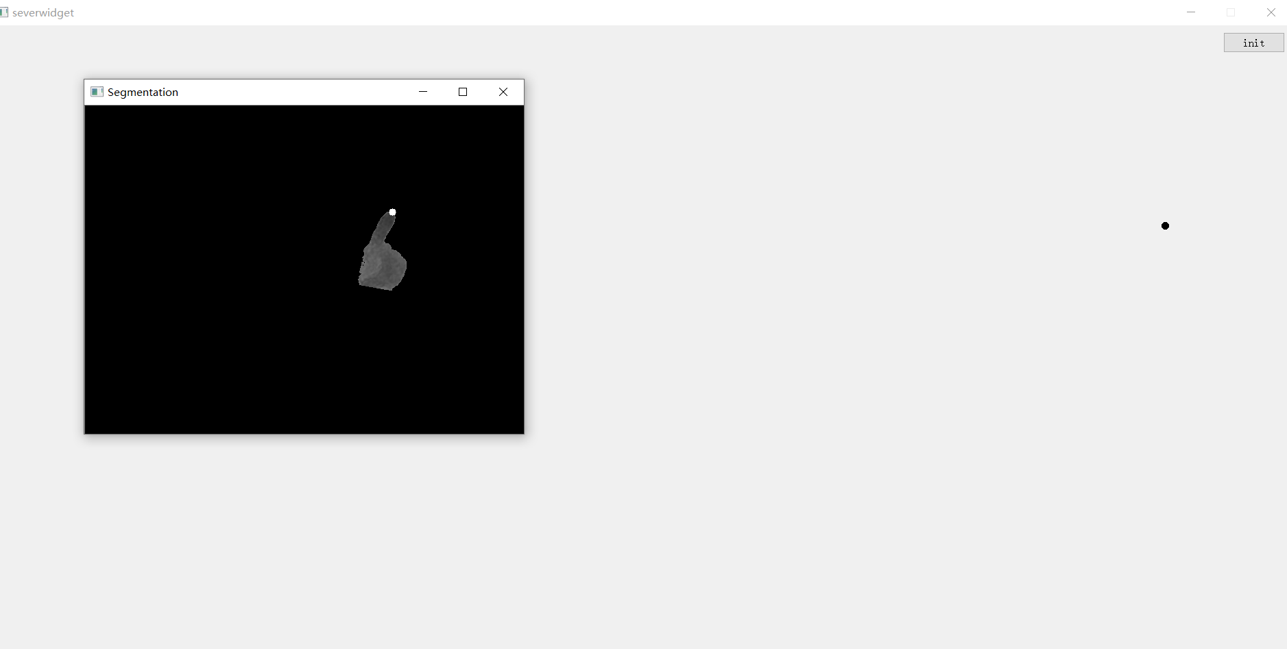
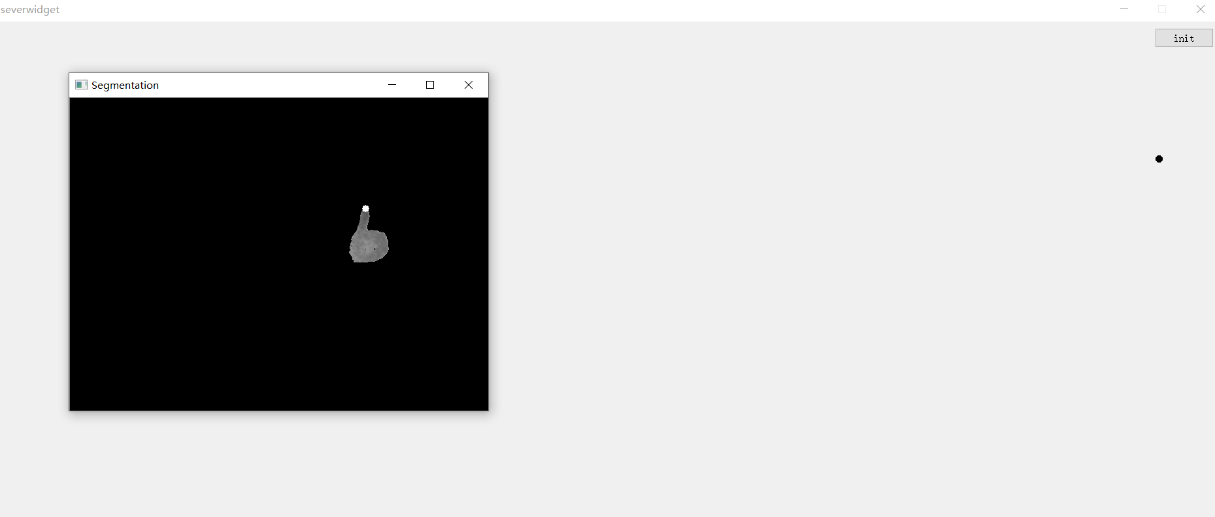
总结Summary
Guiding Gui 存在的问题
Problems with Guiding GUI
【1】跟踪手指过程中，当指尖点X,Y不变，Z不断改变时，在屏幕中显示的点会发生移动(理想状态是X,Y不变，Z改变在屏幕上点会静止。)
During fingertip tracking, when the fingertip X, Y and Z change continuously, the point displayed on the screen will move (ideally, X, Y do not change, Z change will be static on the screen point).
问题的原因：可能在标定时标定的4组点处于同一平面，没选取不同空间的点进行标定。Reason for the problem: Four sets of points that may be calibrated at the time of calibration are on the same plane, and points in different spaces are not selected for calibration.
解决方案：后期增加标点选点的个数，将选点涵盖到空间。
Solution: Increase the number of punctuation points later to cover the space.

Slide 50
总结Summary
【2】手势静止状态下，显示在屏幕上的点会发生抖动。
When the gesture is still, the point displayed on the screen will shake.
问题的原因：可能是手势在静止情况下，相机获取的3D坐标发生1-2mm的偏差，在经过RT换算成像素坐标后，偏差扩大了好多倍，因此会出现明显的抖动
The cause of the problem：It may be that when the gesture is still, the 3D coordinates obtained by the camera have a deviation of 1-2mm. After being converted into pixel coordinates by RT, the deviation is enlarged by many times, so there will be obvious jitter
解决方案：后期会将窗口的分辨率重新分块，让显示在同一分块的坐标值都相等。
Solution：Later, the resolution of the window will be re divided into blocks, so that the coordinate values displayed in the same block are equal.

Slide 51
无锡威莱斯电子有限公司
总结Summary
【2】手势静止状态下，显示在屏幕上的点会发生抖动。
When the gesture is still, the point displayed on the screen will shake.
问题的原因：可能是手势在静止情况下，相机获取的3D坐标发生1-2mm的偏差，在经过RT换算成像素坐标后，偏差扩大了好多倍，因此会出现明显的抖动
The cause of the problem：It may be that when the gesture is still, the 3D coordinates obtained by the camera have a deviation of 1-2mm. After being converted into pixel coordinates by RT, the deviation is enlarged by many times, so there will be obvious jitter
解决方案：后期会将窗口的分辨率重新分块，让显示在同一分块的坐标值都相等。
Solution：Later, the resolution of the window will be re divided into blocks, so that the coordinate values displayed in the same block are equal.

Slide 52
THANKS

